Slide 1
Module II The Data Link Layer (DLL)

Slide 2
Module II
Data link layer
Data link layer design issues, Error detection and correction, Sliding window protocols, High-Level Data Link Control (HDLC) protocol.
Medium Access Control (MAC) sublayer –Channel allocation problem, Multiple access protocols, Ethernet, Wireless LANs - 802.11, Bridges & switches - Bridges from 802.x to 802.y, Repeaters, Hubs, Bridges, Switches, Routers and Gateways. .

Slide 3
Data Link Layer Design Issues
Services Provided to the Network Layer
Framing
Error Control
Flow Control

Slide 4
Functions of the Data Link Layer
Provide service interface to the network layer
Dealing with transmission errors
Regulating data flow
Slow receivers not swamped by fast senders

Slide 5
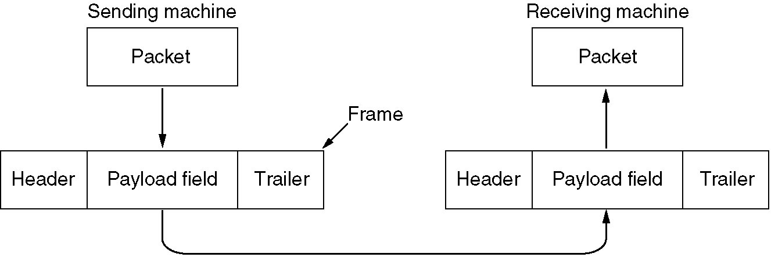
Functions of the Data Link Layer
DLL takes the packets it gets from the network layer.
Encapsulates them into frames for transmission.
Each frame contains a frame header, a payload field for holding the packet, and a frame trailer.
Frame management forms the heart of the DLL.
Relationship between packets and frames.

Slide 6
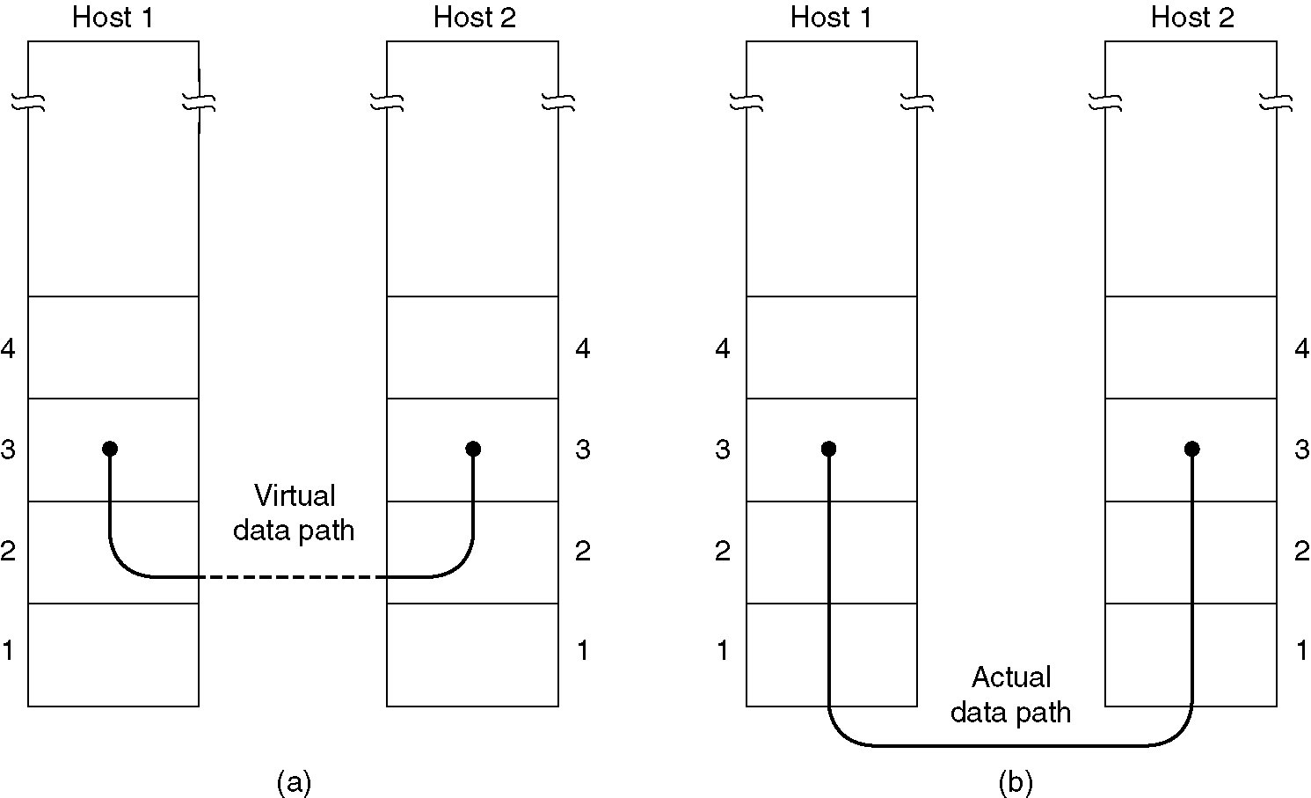
Services provided to the Network Layer
Transfers data from the network layer on the source machine to the network layer on the destination machine
(a) Virtual Communication.
(b) Actual Communication.

Slide 7
Services provided to the Network Layer
DLL commonly provides 3 services
Unacknowledged connectionless service
Acknowledged connectionless service
Acknowledged connection-oriented service

Slide 8
Unacknowledged connectionless service
Source machine send independent frames to the destination machine without having the destination machine acknowledge them
No logical connection is established
If a frame is lost due to noise on the line, no attempt is made to detect the loss or recover from it
This class of service is appropriate when the error rate is very low so that recovery is left to higher layers
Also appropriate for real-time traffic, such as voice, in which late data are worse than bad data
Most LANs use unacknowledged connectionless service

Slide 9
Acknowledged connectionless service
No logical connections
Each frame sent is individually acknowledged
Sender knows whether a frame has arrived correctly
If it has not arrived within a specified time interval, it can be sent again.
This service is useful over unreliable channels, such as wireless systems
If the average packet is broken up into, say, 10 frames, and 20 percent of all frames are lost, it may take a very long time for the packet to get through.
If individual frames are acknowledged and retransmitted, entire packets get through much faster.

Slide 10
Acknowledged connection-oriented service
Source and destination machines establish a connection before any data are transferred.
Each frame sent over the connection is numbered
DLL guarantees that each frame sent is indeed received.
It also guarantees that each frame is received exactly once and that all frames are received in the right order.
With connectionless service, it is conceivable that a lost acknowledgement causes a packet to be sent several times and thus received several times

Slide 11
Acknowledged connection-oriented service
Transfer in 3 phases
Phase 1
Connection is established by having both sides initialize variables and counters needed to keep track of which frames have been received and which ones have not
Phase 2
One or more frames are actually transmitted
Phase 3
Connection is released, freeing up the variables, buffers, and other resources used to maintain the connection

Slide 12
Framing
DLL accepts bits from Physical layer and it detect and correct errors.
Usual approach is for the DLL to break the bit stream up into discrete frames and compute the checksum for each frame
When a frame arrives at the destination, the checksum is recomputed.
If the newly-computed checksum is different from the one contained in the frame, the DLL knows that an error has occurred and takes steps to deal with it
e.g., discarding the bad frame and possibly also sending back an error report

Slide 13
Framing
Breaking the bit stream up into frames is more difficult than it appears
One method is to insert time gaps between frames, much like the spaces between words in ordinary text.
However, networks rarely make any guarantees about timing
It is possible that these gaps might be squeezed out or other gaps might be inserted during transmission
So, it is difficult to count on timing to mark the start and end of each frame
Other methods
Character count.
Flag bytes with byte stuffing.
Starting and ending flags, with bit stuffing.
Physical layer coding violations.

Slide 14
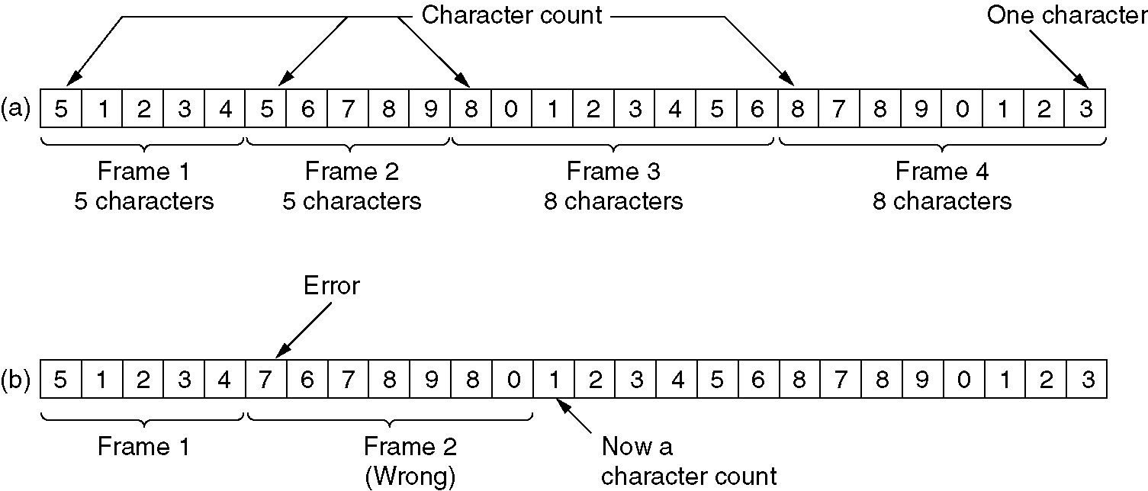
Character count
Uses a field in the header to specify the number of characters in the frame
When the DLL at the destination sees the character count, it knows how many characters follow and hence where the end of the frame is
Eg: A character stream. (a) Without errors. (b) With one error.

Slide 15
Character count
Problem with this algorithm
Count can be garbled by a transmission error
if the character count of 5 in the second frame becomes a 7, the destination will get out of synchronization
destination will be unable to locate the start of the next frame even if the checksum is incorrect
destination does not know how many characters to skip over to get to the start of the retransmission
So, character count method is rarely used

Slide 16
Flag bytes with byte stuffing
Solves the problem of resynchronization after an error by having each frame start and end with special bytes
Earlier, the starting and ending bytes were different
But in recent years, most protocols have used the same byte, called a FLAG byte, as both the starting and ending delimiter
If the receiver ever loses synchronization, it can just search for the flag byte to find the end of the current frame.
Two consecutive flag bytes indicate the end of one frame and start of the next one

Slide 17
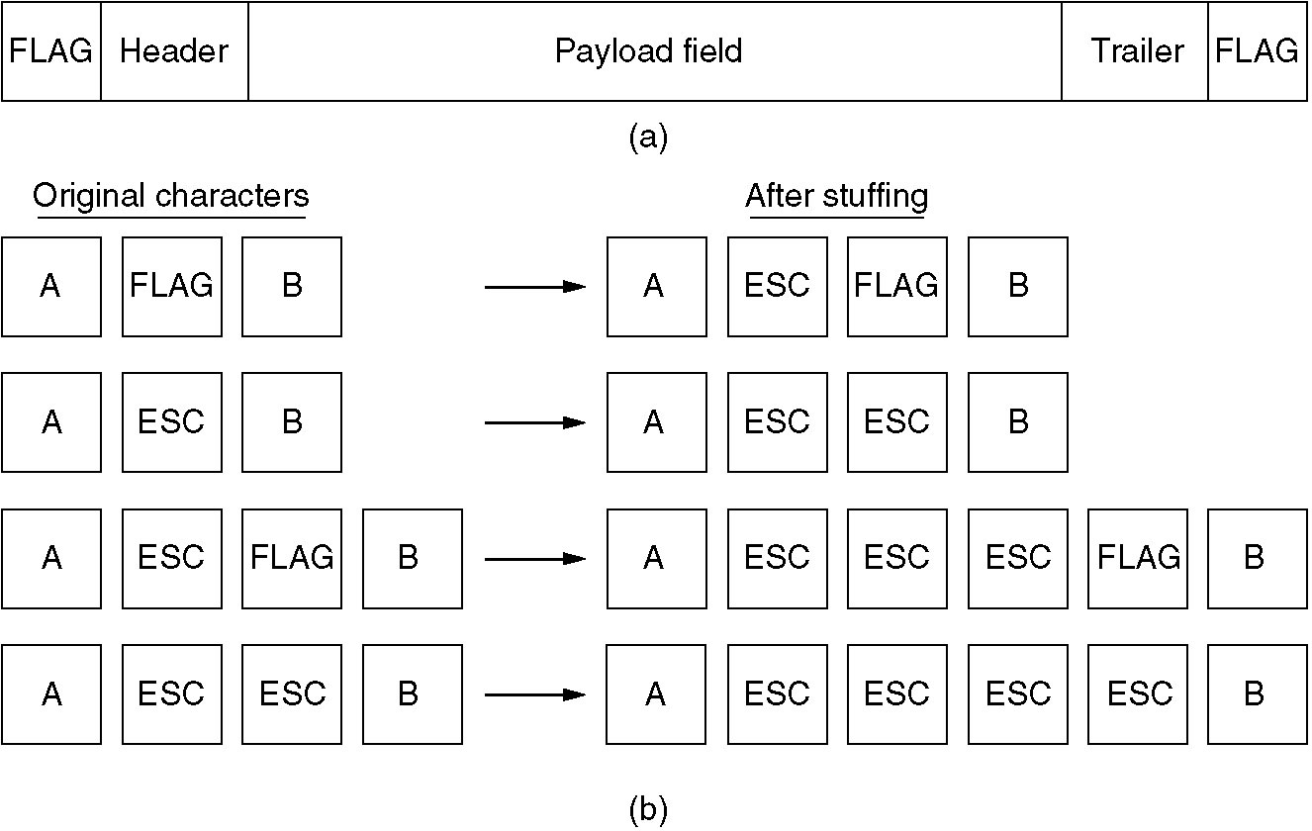
(a) A frame delimited by flag bytes.
(b) Four examples of byte sequences before and after stuffing.

Slide 18
Flag bytes with byte stuffing
Problem with this method:
when binary data, such as object programs or floating-point numbers, are being transmitted.
It may easily happen that the flag byte's bit pattern occurs in the data
Solution:
To have the sender's DLL insert a special escape byte (ESC) just before each ''accidental'' flag byte in the data.
The DLL on the receiving end removes the escape byte before the data are given to the network layer.
This technique is called byte stuffing or character stuffing.
Thus, a framing flag byte can be distinguished from one in the data by the absence or presence of an escape byte before it

Slide 19
Flag bytes with byte stuffing
If an escape byte occurs in the middle of the data, it is also stuffed with an escape byte.
Thus, any single escape byte is part of an escape sequence, whereas a doubled one indicates that a single escape occurred naturally in the data
Application:
Used in PPP (point-to-point protocol)
most home computers use PPP to communicate with their Internet service provider
Disadvantage of this framing method
it is closely tied to the use of 8-bit characters
Not all character codes use 8-bit characters.
UNICODE uses 16-bit characters

Slide 20
Starting and ending flags, with bit stuffing
A new technique developed to allow arbitrary sized characters
Allows character codes with an arbitrary number of bits per character
Each frame begins and ends with a special bit pattern, 01111110 (in fact, a flag byte).
Whenever the sender's DLL encounters 5 consecutive 1s in the data, it automatically stuffs a 0 bit into the outgoing bit stream.
This bit stuffing is analogous to byte stuffing,
in which an escape byte is stuffed into the outgoing character stream before a flag byte in the data

Slide 21
Problems

Slide 22
Given the output after byte-stuffing:
FLAG A B ESC ESC C ESC ESC ESC FLAG ESC FLAG D F FLAG
What is the original data?

Slide 23
solution
ANS: A B ESC C ESC FLAG FLAG D F

Slide 24
Starting and ending flags, with bit stuffing
When the receiver sees 5 consecutive incoming 1 bits, followed by a 0 bit, it automatically destuffs (i.e., deletes) the 0 bit.
Just as byte stuffing, bit stuffing is completely transparent to the network layer in both computers
If the user data contain the flag pattern, 01111110, this flag is transmitted as 011111010 but stored in the receiver's memory as 01111110.
With bit stuffing, the boundary between two frames can be unambiguously recognized by the flag pattern.
Thus, if the receiver loses track of where it is, all it has to do is scan the input for flag sequences,
since they can only occur at frame boundaries and never within the data

Slide 25
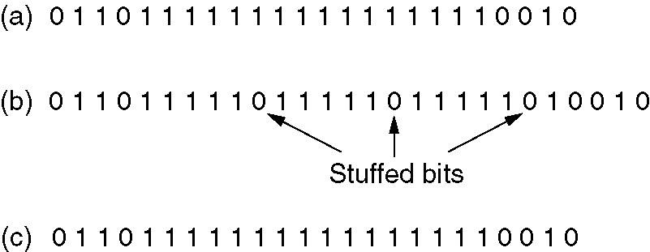
Framing (Bit stuffing)
Bit stuffing
(a) The original data.
(b) The data as they appear on the transmission line.
(c) The data as they are stored in receiver’s memory after destuffing.

Slide 26
A bit string, 0111101111101111110, needs to be transmitted at the data link layer. What is the string actually transmitted after bit stuffing?
Ans
The output is 011110111110011111010

Slide 27
Physical layer coding violations
Only applicable to networks in which the encoding on the physical medium contains some redundancy
Normally, a 1 bit is a high-low pair and a 0 bit is a low-high pair.
The scheme means that every data bit has a transition in the middle, making it easy for the receiver to locate the bit boundaries.
The combinations high-high and low-low are not used for data but are used for delimiting frames in some protocols

Slide 28
Conclusion:
Most data link protocols use a combination of a character count with one of the other methods for extra safety.
When a frame arrives, the count field is used to locate the end of the frame.
Only if the appropriate delimiter is present at that position and the checksum is correct, the frame is accepted as valid.
Otherwise, the input stream is scanned for the next delimiter

Slide 29
Error Control
To make sure all frames are eventually delivered to the network layer at the destination and in the proper order
For reliable delivery, protocol calls for the receiver send back special control frames bearing positive or negative acknowledgements about the incoming frames
Problem:
hardware troubles may cause a frame to vanish completely (e.g., in a noise burst).
Solution:
by introducing timers into the DLL

Slide 30
Use of Timer in DLL
When the sender transmits a frame, it generally also starts a timer.
The timer is set to expire after an interval long enough for the frame to reach the destination, be processed there, and have the acknowledgement propagate back to the sender.
acknowledgement will get back before the timer runs out
in which case the timer will be canceled
if either the frame or the acknowledgement is lost, the timer will go off, alerting the sender to a potential problem.
The obvious solution is to just transmit the frame again
Another Problem : receiving frames multiple times
Solution:
to assign sequence numbers to outgoing frames, so that the receiver can distinguish retransmissions from originals

Slide 31
Flow Control
how to keep a fast sender from overloading a slow receiver with data
Two approaches
feedback-based flow control
the receiver sends back information to the sender giving it permission to send more data or at least telling the sender how the receiver is doing
rate-based flow control
the protocol has a built-in mechanism that limits the rate at which senders may transmit data, without using feedback from the receiver
The protocol contains well-defined rules about when a sender may transmit the next frame

Slide 32
Error detection and correction

Slide 33
Networks must be able to transfer data from one device to another with complete accuracy.
Data can be corrupted during transmission.
For reliable communication, errors must be detected and corrected.
To deal with them we use 2 mechanisms.
Error detection and Error correction are implemented either at the data link layer or the transport layer of the OSI model.

Slide 34
Types of error
1. Single-bit error

Slide 35
2. Burst error
Burst errors does not necessarily mean that the errors occur in consecutive bits, the length of the burst is measured from the first corrupted bit to the last corrupted bit. Some bits in between may not have been corrupted.

Slide 36
Error-Correcting Codes:
Strategy 1: uses error-correcting codes
to include enough redundant information along with each block of data sent,
to enable the receiver to deduce what the transmitted data must have been
The use of error-correcting codes is referred to as FEC (Forward Error Correction).
Strategy 2: uses error-detecting codes
to include only enough redundancy to allow the receiver to deduce that an error occurred
have to request a retransmission.

Slide 37
Error Detection and Correction
Applications:
On channels that are highly reliable, such as fiber, it is cheaper to use an error detecting code and just retransmit the occasional block found to be faulty.
On channels such as wireless links that make many errors, it is better to use error correcting code rather than relying on a retransmission, which itself may be in error

Slide 38
Error-Correcting Codes
Four different error-correcting codes:
1. Hamming codes.
2. Binary convolutional codes.
3. Reed-Solomon codes.
4. Low-Density Parity Check codes.

Slide 39
To understand how errors can be handled, it is necessary to look closely at what an error really is
Normally, a frame consists of m data (i.e., message) bits and r redundant or check bits.
Let the total length be n (i.e., n = m + r).
An n-bit unit containing data and check bits is often referred to as an n-bit codeword
Given any two codewords one transmitted and next received,
say, 10001001 and 10110001,

Slide 40

it is possible to determine how many corresponding bits differ.
In this case, 3 bits differ.
To determine how many bits differ, just exclusive OR the two codewords and count the number of 1 bits in the result.
The number of bit positions in which two codewords differ is called the Hamming distance.
Error-detecting and error-correcting properties of a code depend on its Hamming distance

Slide 41
Single bit Error Correction using Hamming code
Calculating the Hamming Code
The key to the Hamming Code is the use of extra parity bits to allow the identification of a single error.
Creating the code word is as follows:
Mark all bit positions that are powers of two as parity bits. (positions 1, 2, 4, 8, 16, 32, 64, etc.)
All other bit positions are for the data to be encoded. (positions 3, 5, 6, 7, 9, 10, 11, 12, 13, 14, 15, 17, etc.)

Slide 43
The position of the parity bit determines the sequence of bits that it alternately checks and skips.
Position 1: check 1 bit, skip 1 bit, check 1 bit, skip 1 bit, etc. (1,3,5,7,9,11,13,15,...) Position 2: check 2 bits, skip 2 bits, check 2 bits, skip 2 bits, etc. (2,3,6,7,10,11,14,15,...) Position 4: check 4 bits, skip 4 bits, check 4 bits, skip 4 bits, etc. (4,5,6,7,12,13,14,15,20,21,22,23,...) Position 8: check 8 bits, skip 8 bits, check 8 bits, skip 8 bits, etc. (8-15,24-31,40-47,...)
Set a parity bit to 1 if the total number of ones in the positions it checks is odd.
Set a parity bit to 0 if the total number of ones in the positions it checks is even.

Slide 44




Example: the message is 1001101
Position 1 checks bits 1,3,5,7,9,11: -,1,0,1,0,1. odd no of 1’s so parity so set position 1 to 1:
Position 2 checks bits 2,3,6,7,10,11: -,1,1,1,0,1. Even no of 1’s. So parity at position 2 is 0:
Position 4 checks bits 4,5,6,7,12: -,0,1,1. Even no of 1’s. So parity at position 4 is 0 :

Slide 45

Position 8 checks bits 8,9,10,11,12: -0,0,1. odd no of 1’s so parity so set position 8 to 1 :
So the Code word is 10011100101.
Finding and fixing a single bit error
Suppose the word that was received was 10010100101. instead.
Then the receiver could calculate which bit was wrong and correct it.
The method is to verify each check bit.

Slide 46
Write down all the incorrect parity bits.
Doing so, we will discover which parity bits are incorrect.
In general, check each parity bit and add the positions that are wrong, this will give you the location of the bad bit.

Slide 47

Redundant bits are extra binary bits that are generated and added to the information-carrying bits of data transfer to ensure that no bits were lost during the data transfer.
The number of redundant bits can be calculated using the following formula:
Given m, this puts a lower limit on the number of check bits needed to correct single errors.

Slide 48
Eg: Suppose the data to be transmitted is 1011001, how many redundancy bits are required. Also calculate the code word using Hamming code method.

Slide 49
Error-Detecting Codes:
It is to include only enough redundancy to allow the receiver to deduce that an error occurred
have to request a retransmission.

Slide 50
Error Detection
Using copper wire or fiber, the error rate is much lower
so error detection and retransmission is usually more efficient for dealing with the occasional error
Different error-detecting codes are:
1. Parity.
2. Cyclic Redundancy Checks (CRCs).

Slide 51
Parity
The parity bit is chosen so that the number of 1 bits in the codeword is even (or odd).
Doing this is equivalent to computing the (even) parity bit as the modulo 2 sum or XOR of the data bits.
For example, when 1011010 is sent in even parity, a bit is added to the end to make it 10110100.
With odd parity 1011010 becomes 10110101.
This means that it can detect single-bit errors.

Slide 52
Another method to protect against burst errors: we can compute the parity bits over the data in a different order than the order in which the data bits are transmitted which is called interleaving.
In this case, we will compute a parity bit for each of the n columns and send all the data bits as k rows, sending the rows from top to bottom and the bits in each row from left to right in the usual manner.
At the last row, we send the n parity bits.
This transmission order is shown in Fig. for n = 7 and k = 7.

Slide 53
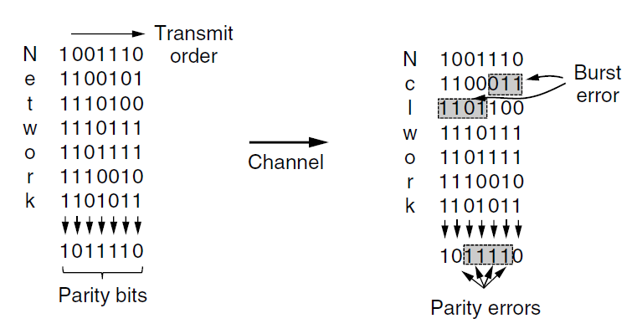

Slide 54
Interleaving is a general technique to convert a code that detects (or corrects) isolated errors into a code that detects (or corrects) burst errors.
In Fig, when a burst error of length n = 7 occurs, the bits that are in error are spread across different columns.
At most 1 bit in each of the n columns will be affected, so the parity bits on those columns will detect the error.
This method uses n parity bits on blocks of kn data bits to detect a single burst error of length n or less.
A burst of length n + 1 will pass undetected, however, if the first bit is inverted, the last bit is inverted, and all the other bits are correct.

Slide 55
Another method is in widespread use:
The polynomial code, also known as a CRC (Cyclic Redundancy Check)
Polynomial codes are based upon treating bit strings as representations of polynomials with coefficients of 0 and 1 only
A k-bit frame is regarded as the coefficient list for a polynomial with k terms, ranging from x^{k - 1} to x⁰
Such a polynomial is said to be of degree k - 1.
The high-order (leftmost) bit is the coefficient of x^{k - 1}; the next bit is the coefficient of x^{k - 2}, and so on.
For example, 110001 has 6 bits and thus represents a six-term polynomial with coefficients 1, 1, 0, 0, 0, and 1:
x⁵ + x⁴ + x⁰

Slide 58
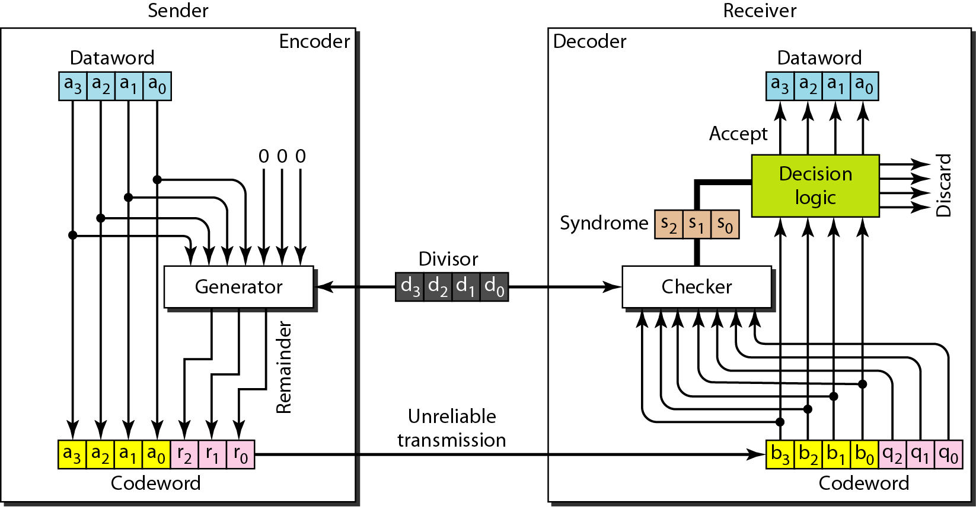
CRC encoder and decoder

Slide 59
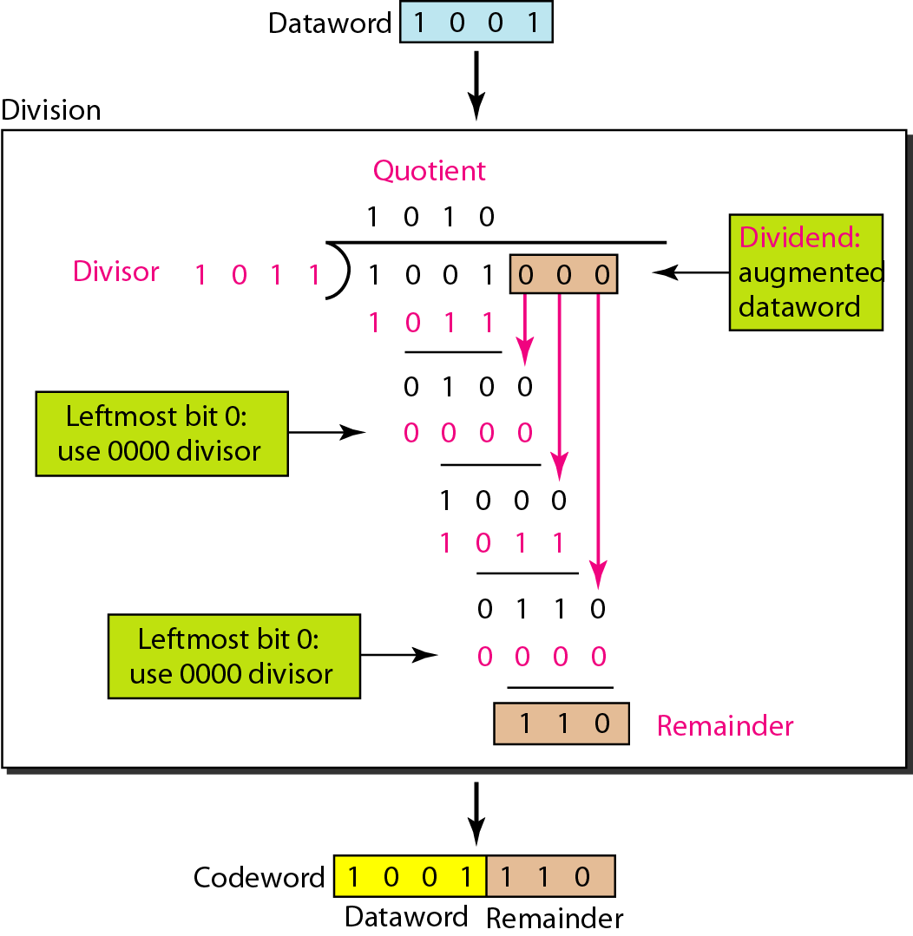
Division in CRC encoder

Slide 60
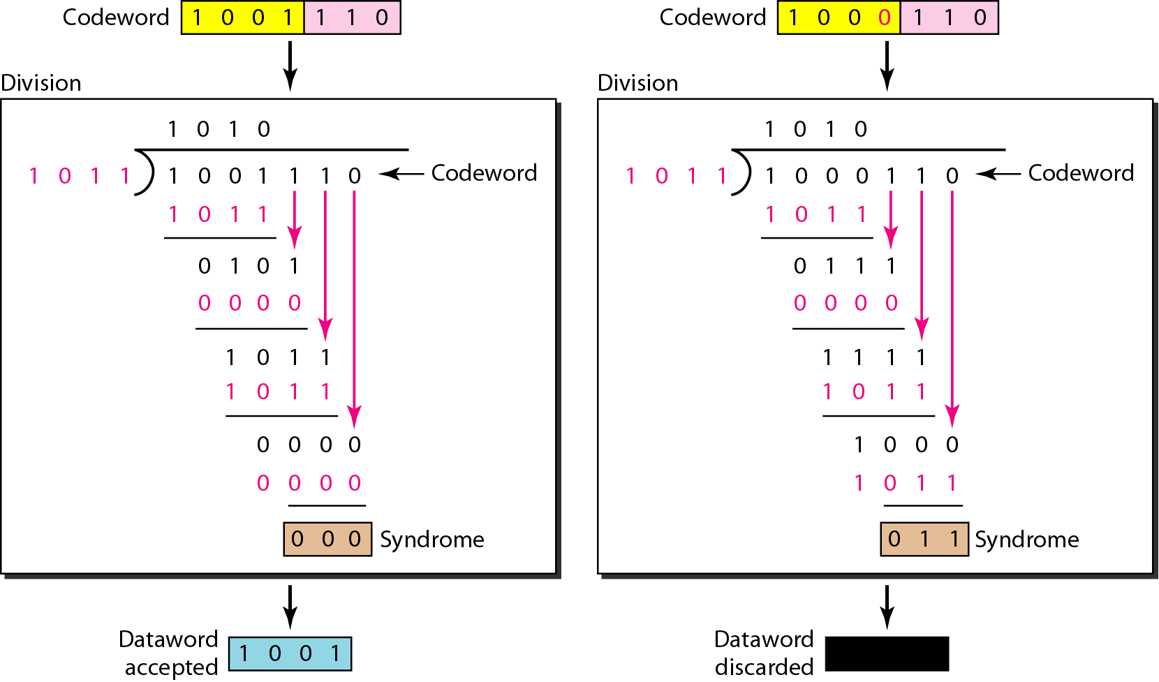
Division in the CRC decoder for two cases

Slide 61
Error Detection
When the polynomial code method is employed, the sender and receiver must agree upon a generator polynomial, G(x), in advance.
Both the high- and low-order bits of the generator must be 1.
To compute the checksum for some frame with m bits, corresponding to the polynomial M(x), the frame must be longer than the generator polynomial.
The idea is to append a checksum to the end of the frame in such a way that the polynomial represented by the checksummed frame is divisible by G(x).
When the receiver gets the checksummed frame, it tries dividing it by G(x).
If there is a remainder, there has been a transmission error.

Slide 62
Error Detection
The algorithm for computing the checksum is as follows:
1.Let r be the degree of G(x). Append r zero bits to the low-order end of the frame so it now contains m + r bits and corresponds to the polynomial xM^{r}(x).
2.Divide the bit string corresponding to G(x) into the bit string corresponding to xM^{r}(x), using modulo 2 division.
3.Subtract the remainder (which is always r or fewer bits) from the bit string corresponding to xM^{r}(x) using modulo 2 subtraction. The result is the checksummed frame to be transmitted. Call its polynomial T(x).

Slide 63
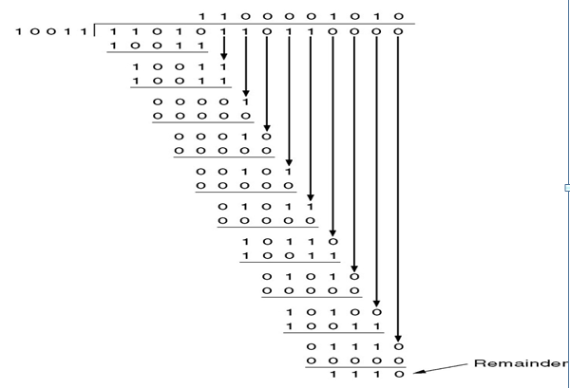


Error-Detecting Codes
Fig: Illustrates the calculation for a frame 1101011011
using the generator G(x) = x⁴ + x + 1

Slide 64
Error-Detecting Codes
1 1 0 0 0 0 1 0 1 0
1 0 0 1 1 1 1 0 1 0 1 1 0 1 1 1 1 1 0
1 0 0 1 1
1 0 0 1 1
1 0 0 1 1
0 0 0 0 1
0 0 0 0 0
0 0 0 1 0
0 0 0 0 0
0 0 1 0 1
0 0 0 0 0
0 1 0 1 1
0 0 0 0 0
1 0 1 1 1
1 0 0 1 1
0 1 0 0 1
0 0 0 0 0
1 0 0 1 1
1 0 0 1 1
0 0 0 0 0
0 0 0 0 0
0 0 0 0
Fig: Illustrates the calculation for a frame 1101011011 using the generator G(x) = x⁴ + x + 1
Remainder is 0, so no errors

Slide 65
Transmitted code is: 100100001

Slide 66
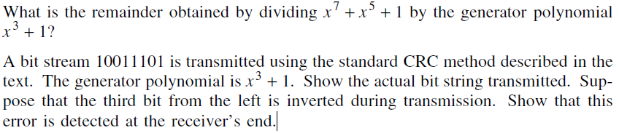

Slide 67
Sliding Window Protocols

Slide 68
Full-duplex data transmission is to have two separate communication channels and use each one for simplex data traffic (in different directions).
If this is done, we have two separate physical circuits, each with a ''forward'' channel (for data) and a ''reverse'' channel (for acknowledgements).
In which cases, the bandwidth of the reverse channel is almost entirely wasted.
In effect, the user is paying for two circuits but using only the capacity of one
A better idea is to use the same circuit for data in both directions.

Slide 69
Data frames from A to B are intermixed with the acknowledgement frames from A to B.
By looking at the kind field in the header of an incoming frame, the receiver can tell whether the frame is data or acknowledgement
Another improvement is possible: When a data frame arrives, instead of immediately sending a separate control frame, the receiver restrains itself and waits until the network layer passes it the next packet.
The acknowledgement is attached to the outgoing data frame (using the ack field in the frame header).
In effect, the acknowledgement gets a free ride on the next outgoing data frame.

Slide 70
The technique of temporarily delaying outgoing acknowledgements so that they can be hooked onto the next outgoing data frame is known as piggybacking
The principal advantage of using piggybacking over having distinct acknowledgement frames
better use of the available channel bandwidth.
The ack field in the frame header costs only a few bits, whereas a separate frame would need a header, the acknowledgement, and a checksum.

Slide 71
Piggybacking introduces a complication not present with separate acknowledgements.
How long should the data link layer wait for a packet onto which to piggyback the acknowledgement?
If the data link layer waits longer than the sender's timeout period, the frame will be retransmitted, defeating the whole purpose of having acknowledgements.
Of course, the data link layer cannot foretell the future
So it must take an option to use a scheme, such as waiting a fixed number of milliseconds.
If a new packet arrives quickly, the acknowledgement is piggybacked onto it;
otherwise, if no new packet has arrived by the end of this time period, the data link layer just sends a separate acknowledgement frame

Slide 72
Sliding Window Protocols
In all sliding window protocols, each outbound frame contains a sequence number, ranging from 0 up to some maximum
Maximum is usually 2^{n} - 1 so the sequence number fits exactly in an n-bit field.

Slide 73
Essence of all sliding window protocols
at any instant of time, the sender maintains a set of sequence numbers corresponding to frames it is permitted to send.
These frames are said to fall within the sending window.
Similarly, the receiver also maintains a receiving window corresponding to the set of frames it is permitted to accept.

Slide 74
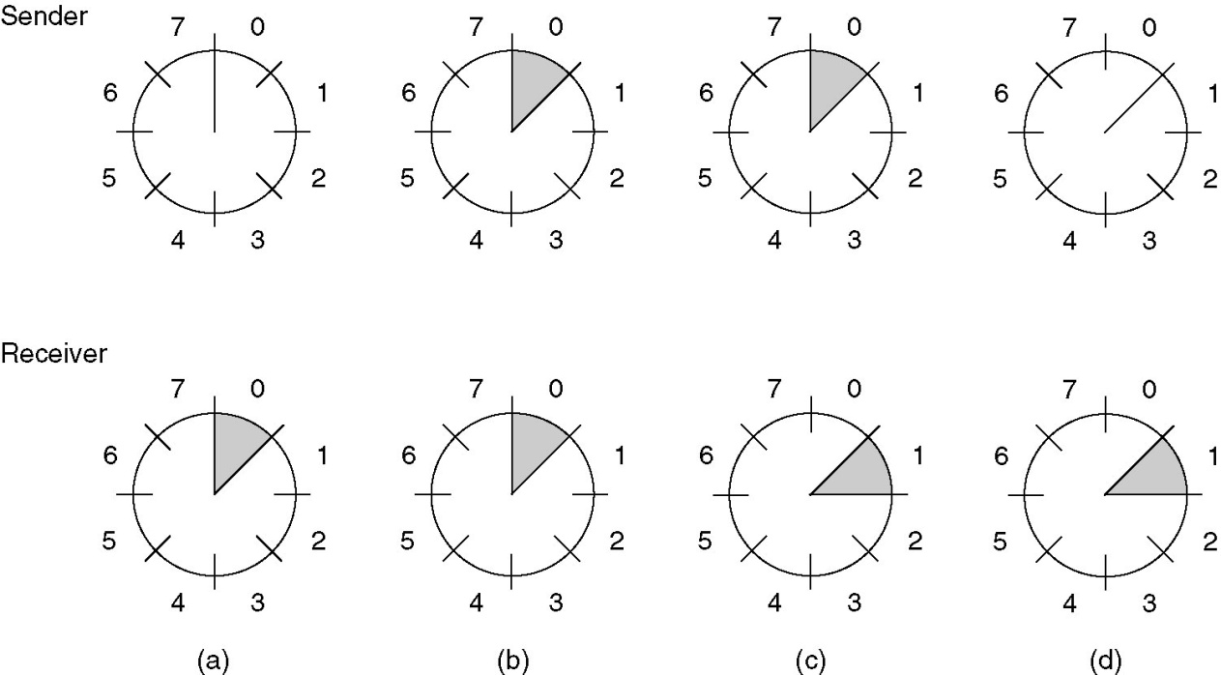
Sliding Window Protocols
A sliding window of size 1, with a 3-bit sequence number.
(a) Initially.
(b) After the first frame has been sent.
(c) After the first frame has been received.
(d) After the first acknowledgement has been received.

Slide 75
The sender's window and the receiver's window need not have the same lower and upper limits or even have the same size.
The sequence numbers within the sender's window represent frames that have been sent or can be sent but are as yet not acknowledged.
Whenever a new packet arrives from the network layer, it is given the next highest sequence number, and the upper edge of the window is advanced by one.
When an acknowledgement comes in, the lower edge is advanced by one. In this way the window continuously maintains a list of unacknowledged frames.

Slide 76
Since frames currently within the sender's window may ultimately be lost or damaged in transit, the sender must keep all these frames in its memory for possible retransmission.
Thus, if the maximum window size is n, the sender needs n buffers to hold the unacknowledged frames.
If the window ever grows to its maximum size, the sending data link layer must forcibly shut off the network layer until another buffer becomes free
The receiver window corresponds to the frames it may accept.
Any frame falling outside the window is discarded without comment.

Slide 77
When a frame whose sequence number is equal to the lower edge of the window is received, it is passed to the network layer, an acknowledgement is generated, and the window is rotated by one.
Unlike the sender's window, the receiver's window always remains at its initial size.
Note that a window size of 1 means that the data link layer only accepts frames in order, but for larger windows this is not so.

Slide 78
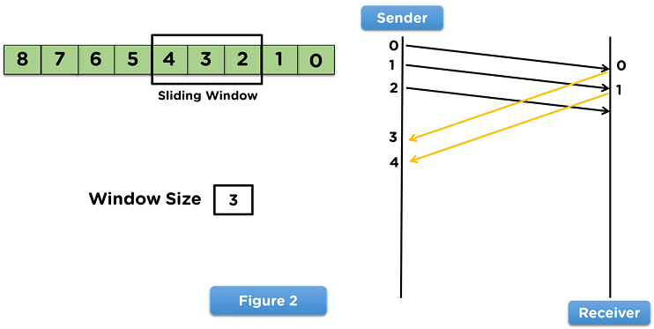

Slide 79
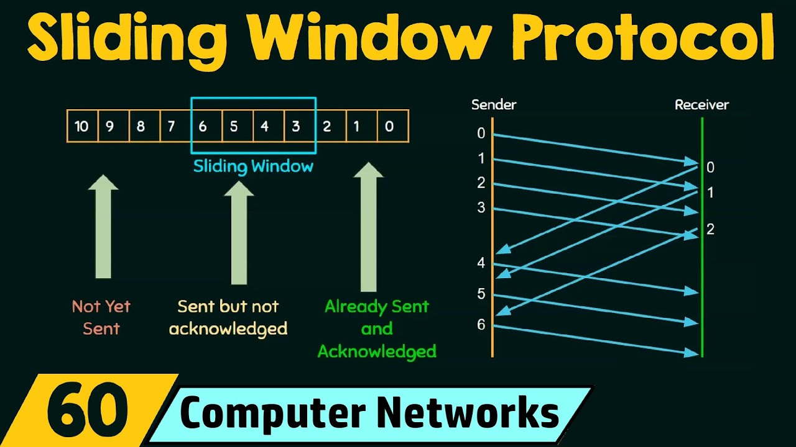

Slide 80
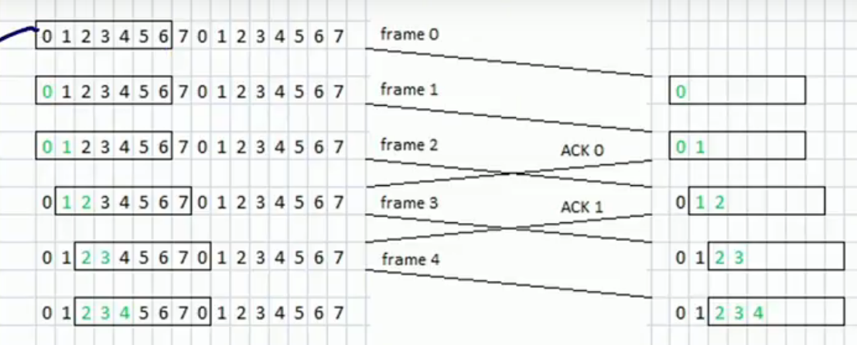

Slide 81
Sliding Window Protocols
Bidirectional Protocols
A One-Bit Sliding Window Protocol
A Protocol Using Go Back N
A Protocol Using Selective Repeat
Three protocols differ among themselves in terms of efficiency, complexity, and buffer requirements

Slide 82
A One-Bit Sliding Window Protocol
A sliding window protocol with a maximum window size of 1.
Such a protocol uses stop-and-wait since the sender transmits a frame and waits for its acknowledgement before sending the next one
Starting machine fetches the first packet from its network layer, builds a frame from it, and sends it.
When this frame arrives, the receiving data link layer checks to see if it is a duplicate
If the frame is the one expected, it is passed to the network layer and the receiver's window is slid up

Slide 83
A One-Bit Sliding Window Protocol
The acknowledgement field contains the number of the last frame received without error.
If this number agrees with the sequence number of the frame the sender is trying to send, the sender knows it is done with the frame stored in buffer and can fetch the next packet from its network layer.
If the sequence number disagrees, it must continue trying to send the same frame.

Slide 84
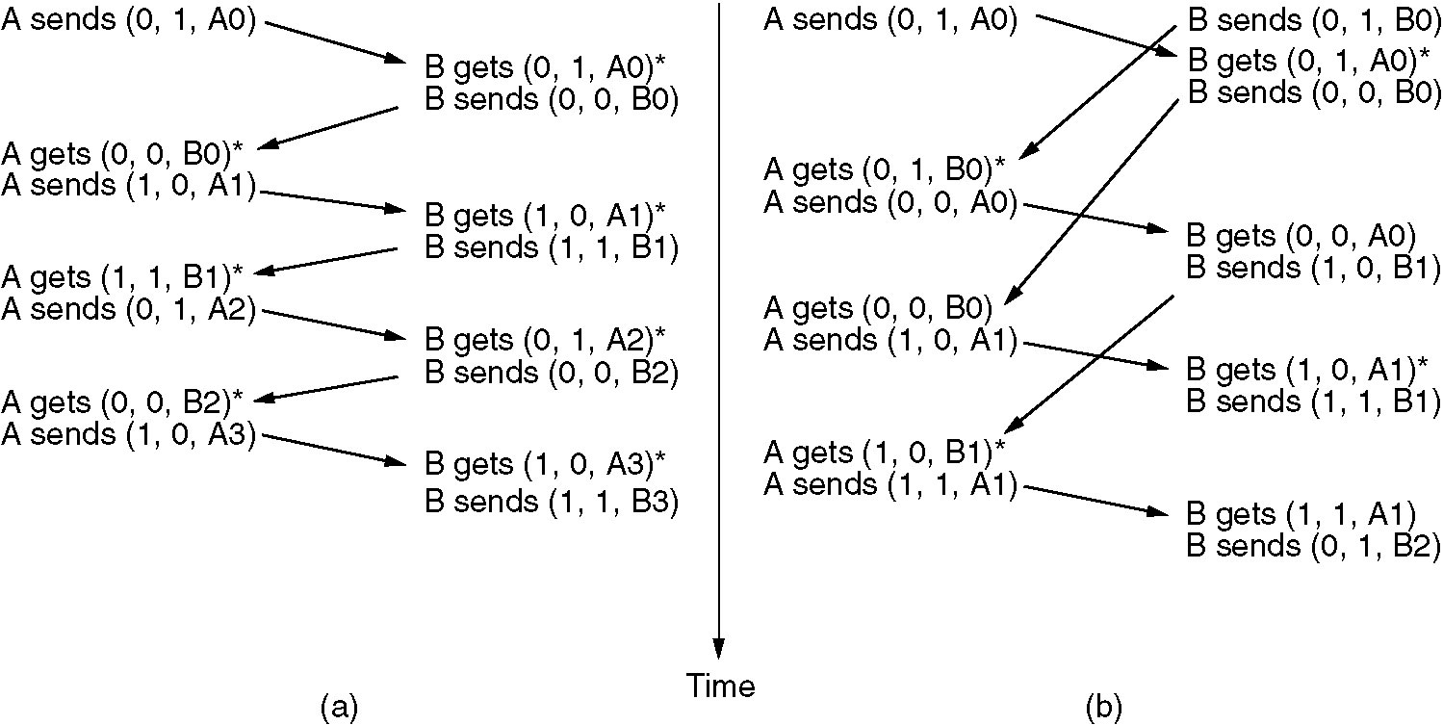
Scenario (a) Normal case.
The notation is (seq, ack, packet number).
An asterisk indicates where a network layer accepts a packet.

Slide 85
Scenario (b) Abnormal case .
The notation is (seq, ack, packet number).
An asterisk indicates where a network layer accepts a packet.

Slide 86
Sliding Window Protocol Using Go Back N
Until now we have made the assumption that the transmission time required for a frame to arrive at the receiver plus the transmission time for the acknowledgement to come back is negligible.
Sometimes this assumption is clearly false.
In these situations the long round-trip time can have important implications for the efficiency of the bandwidth utilization.
The need for a large window on the sending side occurs whenever the product of bandwidth x round-trip-delay is large.
The product of these two factors basically tells what the capacity of the pipe is, and the sender needs the ability to fill it without stopping in order to operate at peak efficiency
This technique is known as pipelining.

Slide 87
Sliding Window Protocol Using Go Back N
Pipelining frames over an unreliable communication channel raises some serious issues.
First, what happens if a frame in the middle of a long stream is damaged or lost?
Large numbers of succeeding frames will arrive at the receiver before the sender even finds out that anything is wrong.
When a damaged frame arrives at the receiver, it obviously should be discarded, but what should the receiver do with all the correct frames following it?
Remember that the receiving DLL is required to hand packets to the network layer in sequence.

Slide 88
Two basic approaches are available for dealing with errors in the presence of pipelining.
One way, called go back n, is for the receiver simply to discard all subsequent frames, sending no acknowledgements for the discarded frames.
This strategy corresponds to a receive window of size 1.
In other words, the DLL refuses to accept any frame except the next one it must give to the network layer.
If the sender's window fills up before the timer runs out, the pipeline will begin to empty.
Eventually, the sender will time out and retransmit all unacknowledged frames in order, starting with the damaged or lost one.
This approach can waste a lot of bandwidth if the error rate is high.

Slide 89
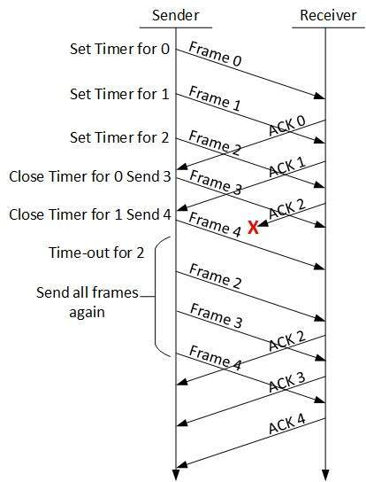

Slide 90
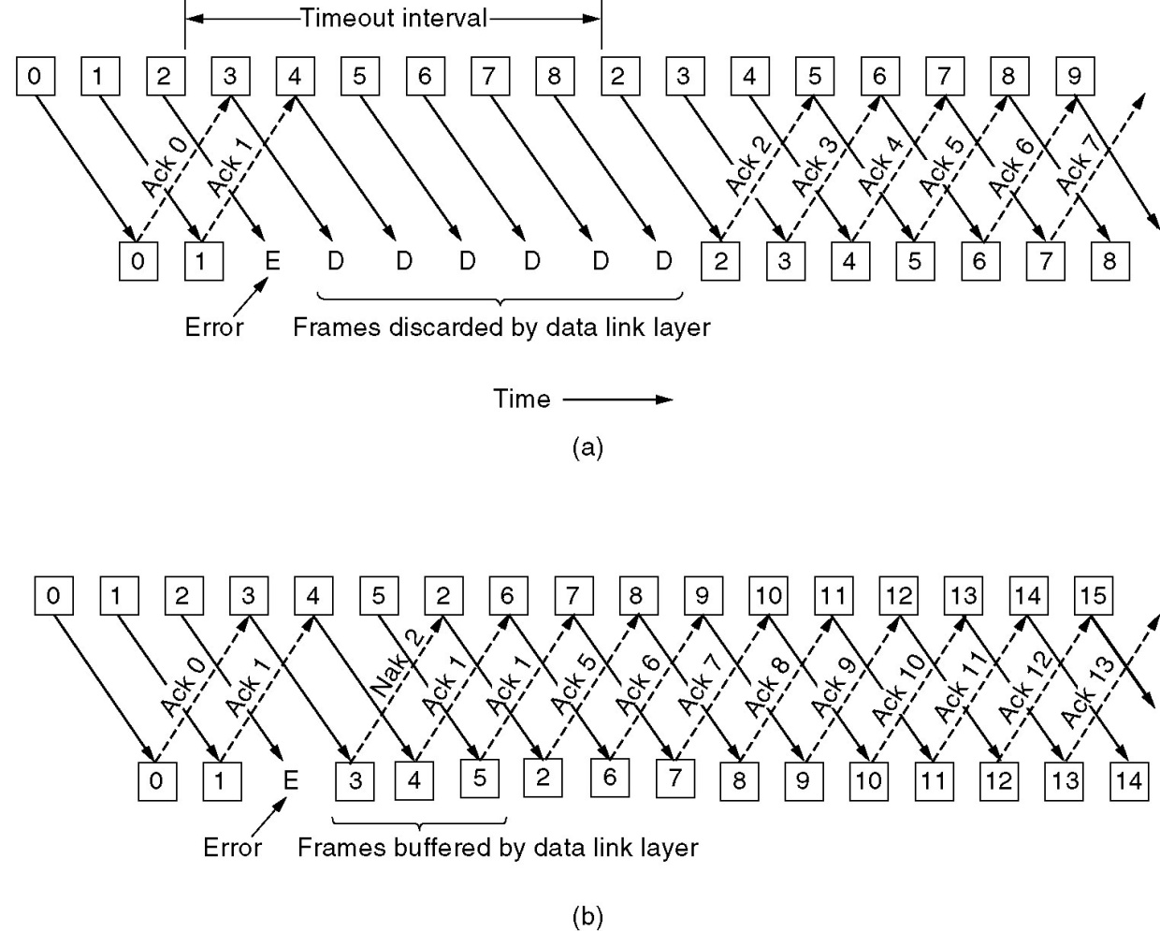
Pipelining and error recovery. Effect on an error when receiver’s window size is 1
Frames 0 and 1 are correctly received and acknowledged.
Frame 2, however, is damaged or lost.
The sender, unaware of this problem, continues to send frames until the timer for frame 2 expires.
Then it backs up to frame 2 and starts all over with it, sending 2, 3, 4, etc. all over again

Slide 91
Go back n Protocol works well if errors are rare
But if the line is poor, it wastes a lot of bandwidth on retransmitted frames.
An alternative strategy for handling errors is to allow the receiver to accept and buffer the frames following a damaged or lost one.
Such a protocol does not discard frames merely because an earlier frame was damaged or lost.

Slide 92
Sliding Window Protocol Using Selective Repeat
Other general strategy for handling errors when frames are pipelined is called selective repeat.
When it is used, a bad frame that is received is discarded, but good frames received after it are buffered.
When the sender times out, only the oldest unacknowledged frame is retransmitted.
If that frame arrives correctly, the receiver can deliver to the network layer, in sequence, all the frames it has buffered.
Selective repeat is often combined with having the receiver send a negative acknowledgement (NAK) when it detects an error,
for example, when it receives a checksum error or a frame out of sequence.
NAKs stimulate retransmission before the corresponding timer expires and thus improve performance

Slide 93
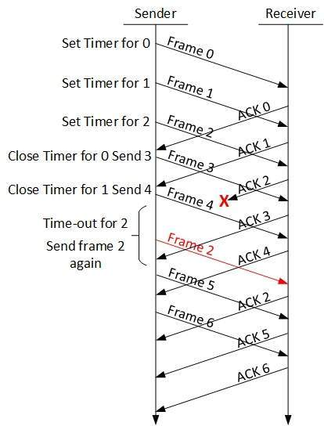

Slide 94
Pipelining and error recovery. Effect on an error when receiver’s window size is large.
4
5
2
Selective repeat corresponds to a receiver window larger than 1
require large amounts of data link layer memory if the window is large

Slide 95
Frames 0 and 1 are again correctly received and acknowledged and frame 2 is lost.
When frame 3 arrives at the receiver, the DLL notices that is has missed a frame
So it sends back a NAK for 2 but buffers 3.
When frames 4 and 5 arrive, they, too, are buffered by the DLL instead of being passed to the network layer.
Eventually, the NAK 2 gets back to the sender, which immediately resends frame 2. When that arrives, the DLL now has 2, 3, 4, and 5 and can pass all of them to the network layer in the correct order.
It can also acknowledge all frames up to and including 5
If the NAK should get lost, eventually the sender will time out for frame 2 and send it, but that may be a quite a while later

Slide 96
In this protocol, both sender and receiver maintain a window of acceptable sequence numbers.
The sender's window size starts out at 0 and grows to some predefined maximum, MAX_SEQ.
The receiver's window is always fixed in size and equal to MAX_SEQ.
The receiver has a buffer reserved for each sequence number within its fixed window.

Slide 97
Non-sequential receive introduces certain problems.
Example:
Suppose that we have a 3-bit sequence number, so that the sender is permitted to transmit up to seven frames before being required to wait for an acknowledgement.
Initially, the sender's and receiver's windows are as shown in Fig. (a).
The sender now transmits frames 0 through 6.
The receiver's window allows it to accept any frame with sequence number between 0 and 6 inclusive.
All seven frames arrive correctly, so the receiver acknowledges them and advances its window to allow receipt of 7, 0, 1, 2, 3, 4, or 5, as shown in Fig. (b).
All seven buffers are marked empty

Slide 98
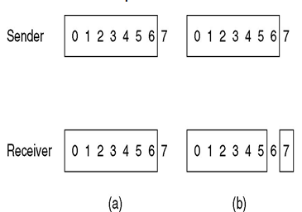
A Sliding Window Protocol Using Selective Repeat
Non-sequential receive introduces certain problems
(a) Initial situation with a window size seven.
(b) After seven frames sent and received, but not acknowledged.

Slide 99
Assume that disaster strikes in the form of a lightning bolt hitting the telephone pole & wiping out all the acknowledgements
The sender eventually times out and retransmits frame 0.
When this frame arrives at the receiver, a check is made to see if it falls within the receiver's window.
Unfortunately, in Fig. (b) frame 0 is within the new window, so it will be accepted.
The receiver sends a piggybacked acknowledgement for frame 6, since 0 through 6 have been received
The sender is happy to learn that all its transmitted frames did actually arrive correctly,

Slide 100
so it advances its window and immediately sends frames 7, 0, 1, 2, 3, 4, and 5.
Frame 7 will be accepted by the receiver and its packet will be passed directly to the network layer.
Immediately thereafter, the receiving DLL checks to see if it has a valid frame 0 already, discovers that it does, and passes the embedded packet to the network layer.
Consequently, the network layer gets an incorrect packet, and the protocol fails

Slide 101
Essence of the problem:
After the receiver advanced its window, the new range of valid sequence numbers overlapped the old one.
Consequently, the following batch of frames might be either duplicates (if all the acknowledgements were lost) or new ones (if all the acknowledgements were received).
The receiver has no way of distinguishing these two cases

Slide 102
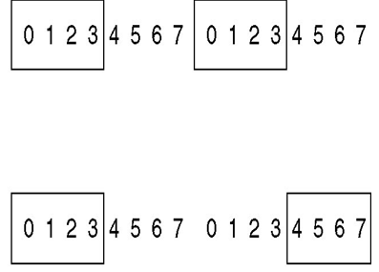
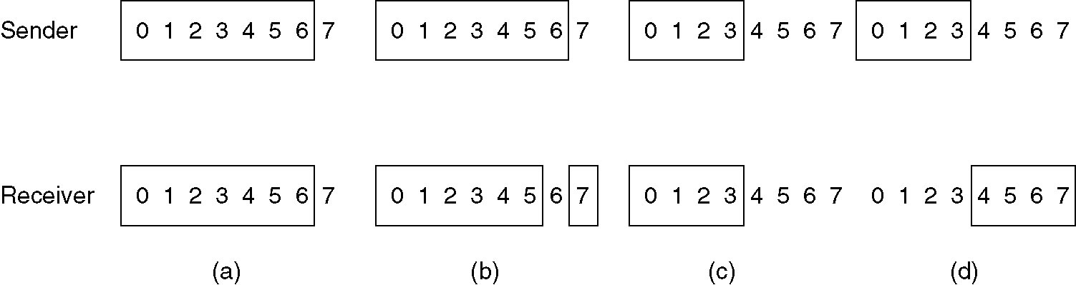
Solution:
To make sure that after the receiver has advanced its window, there is no overlap with the original window
For that,
the maximum window size should be at most half the range of the sequence numbers (MAX_SEQ + 1)/2), as shown in Fig. (c) and Fig. (d)

Slide 103
Data Link Protocols
Two widely-used data link protocols
HDLC – High-Level Data Link Control
HDLC is a classical bit-oriented protocol whose variants have been in use for decades in many applications
Data Link Layer in the Internet
PPP (Point-to-Point Protocol) is the data link protocol used to connect home computers to the Internet

Slide 104
HDLC

Slide 105
History of HDLC:
derived from the data link protocol first used in the IBM mainframe world:
SDLC (Synchronous Data Link Control) protocol.
After developing SDLC, IBM submitted it to ANSI and ISO for acceptance as U.S. and international standards, respectively.
ANSI modified it to become ADCCP (Advanced Data Communication Control Procedure)
ISO modified it to become HDLC (High-level Data Link Control).
CCITT (Consultative Committee for International Telephony and Telegraphy) then adopted and modified HDLC for its LAP (Link Access Procedure) as part of the X.25 network interface standard
but later modified it again to LAPB, to make it more compatible with a later version of HDLC

Slide 106
HDLC provides two common transfer modes that can be used in different configurations:
Normal Response Mode (NRM)
Asynchronous Balanced Mode (ABM).
Normal Response Mode
In normal response mode (NRM), the station configuration is unbalanced.
We have one primary station and multiple secondary stations.
A primary station can send commands ; a secondary station can only respond.
The NRM is used for both point-to-point and multiple-point links.

Slide 107
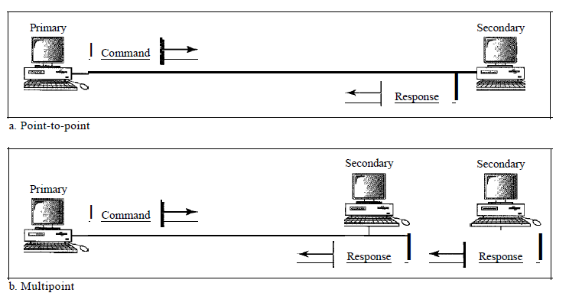

Slide 108
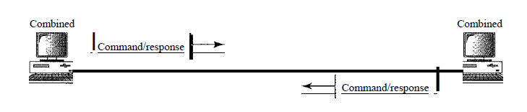
Asynchronous Balanced Mode
In asynchronous balanced mode (ABM), the configuration is balanced.
The link is point-to-point, and each station can function as a primary and a secondary (acting as peers).
This is the common mode today.

Slide 109
Frames
HDLC defines three types of frames:
Information Frames (I-frames)
Supervisory Frames (S-frames)
Unnumbered Frames (U-frames)
Each type of frame serves as an envelope for the transmission of a different type of message.
I-frames are used to transport user data and control information relating to user data (piggybacking).
S-frames are used only to transport control information.
U-frames are reserved for system management. Information carried by U-frames is intended for managing the link itself.

Slide 110
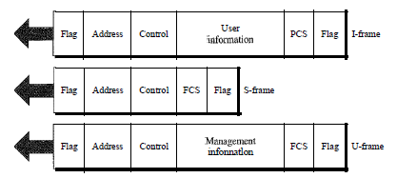
Frame Format
Each frame in HDLC may contain up to six fields, as shown in Figure.
A beginning flag field, an address field, a control field, an information field, a frame check sequence (FCS) field, and an ending flag field.
In multiple-frame transmissions, the ending flag of one frame can serve as the beginning flag of the next frame.

Slide 111
Flag field.
The flag field of an HDLC frame is an 8-bit sequence with the bit pattern 01111110 that identifies both the beginning and the end of a frame and serves as a synchronization pattern for the receiver.
Address field.
The second field of an HDLC frame contains the address of the secondary station. If a primary station created the frame, it contains a to address. If a secondary creates the frame, it contains a from address.
An address field can be 1 byte or several bytes long,
If the address field is only 1 byte, the last bit is always a 1.
If the address is more than 1 byte, all bytes but the last one will end with 0; only the last will end with 1. Ending each intermediate byte with 0 indicates to the receiver that there are more address bytes to come.

Slide 112
Control field
The control field is a 1- or 2-byte segment of the frame used for flow and error control.
The interpretation of bits in this field depends on the frame type.
Information field
The information field contains the user's data from the network layer or management information. Its length can vary from one network to another.
FCS field
The frame check sequence (FCS) is the HDLC error detection field. It can contain either a 2- or 4-byte CRC.

Slide 113
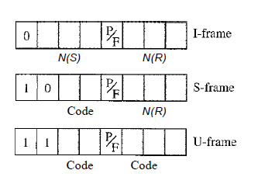
Control Field
The control field determines the type of frame and defines its functionality.
The format is specific for the type of frame, as shown in Figure

Slide 114
Control Field for I-Frames
I-frames are designed to carry user data from the network layer.
They can include flow and error control information (piggybacking).
If the first bit of the control field is 0, this means the frame is an I-frame.
The next 3 bits, called N(S), define the sequence number of the frame. With 3 bits, we can define a sequence number between 0and 7.
The last 3 bits, called N(R), correspond to the acknowledgment number when piggybacking is used.
The single bit between N(S) and N(R) is called the P/F bit.
It has meaning only when it is set (bit = 1) and can mean Poll or Final. It means poll when the frame is sent by a primary station to a secondary. It means final when the frame is sent by a secondary to a primary.

Slide 115
Control Field for S-Frames
Supervisory frames are used for flow and error control whenever piggybacking is either impossible or inappropriate (e.g., when the station either has no data of its own to send or needs to send a command or response other than an acknowledgment).
S-frames do not have information fields. If the first 2 bits of the control field is 10, this means the frame is an S-frame.
The last 3 bits, called N(R), corresponds to the acknowledgment number (ACK) or negative acknowledgment number (NAK) depending on the type of S-frame.
The 2 bits called code is used to define the type of S-frame itself.

Slide 116
With 2 bits, we can have four types of S-frames, as described below:
Receive ready (RR).
If the value of the code subfield is 00, it is an RR S-frame.
This kind of frame acknowledges the receipt of a safe and sound frame or group of frames.
Receive not ready (RNR).
If the value of the code subfield is 10, it is an RNR S-frame.
It acknowledges the receipt of a frame or group of frames, and it announces that the receiver is busy and cannot receive more frames.
It acts as a kind of congestion control mechanism by asking the sender to slow down.

Slide 117
Reject (REJ).
If the value of the code subfield is 01, it is a REJ S-frame.
This is a NAK frame, informing the sender, before the sender time expires, that the last frame is lost or damaged.
Selective reject (SREJ).
If the value of the code subfield is 11, it is an SREJ S-frame.
This is a NAK frame used in Selective Repeat ARQ.

Slide 118
Control Field for U-Frames
Unnumbered frames are used to exchange session management and control information between connected devices.
U-frames contain an information field, but one used for system management information, not user data.
As with S-frames, however, much of the information carried by U-frames is contained in codes included in the control field.
U-frame codes are divided into two sections: a 2-bit prefix before the P/F bit and a 3-bit suffix after the P/F bit. Together, these two segments (5 bits) can be used to create up to 32 different types of U-frames.

Slide 119
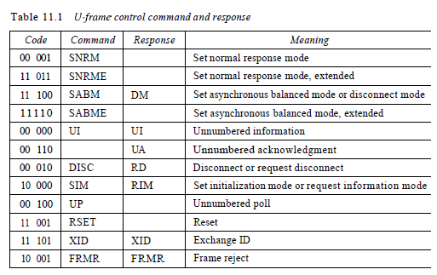

Slide 120
Connection/Disconnection
Node A asks for a connection with a set asynchronous balanced mode (SABM) frame;
Node B gives a positive response with an unnumbered acknowledgment (UA) frame.
After these two exchanges, data can be transferred between the two nodes.
After data transfer, node A sends a DISC (disconnect) frame to release the connection; it is confirmed by node B responding with a UA (unnumbered acknowledgment)

Slide 121
